Slide 1


Provisioning and Automating High Availability Postgres on AWS EC2
Payal Singh
DBA@OmniTI
<number>

Slide 2
Who am I?
DBA@OmniTI
Github: payals
Blog: http://penningpence.blogspot.com
Twitter: @pallureshu
Email: payal@omniti.com
<number>

Slide 3



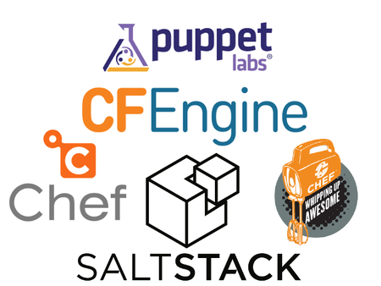
Agenda
vs
Design
Automation
<number>

Slide 4
Why EC2 over RDS?
Control
Debugging
Third party tools
Resources
Flexibility
Migration - globals
Compatibility with non-AWS resources
Monitoring
<number>

Slide 5
If you’re going from RDS to EC2...
More administration
Less handholding
Security
Basic monitoring
<number>

Slide 6

Automation Tools
<number>

Slide 7
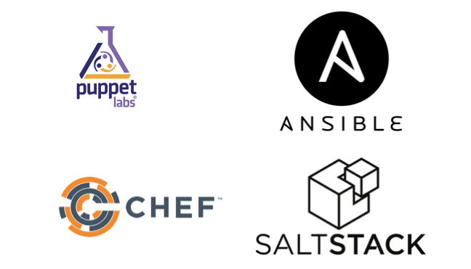
Popular Automation Tools
<number>
Notes:
http://www.infoworld.com/article/2609482/data-center/data-center-review-puppet-vs-chef-vs-ansible-vs-salt.html

Slide 8
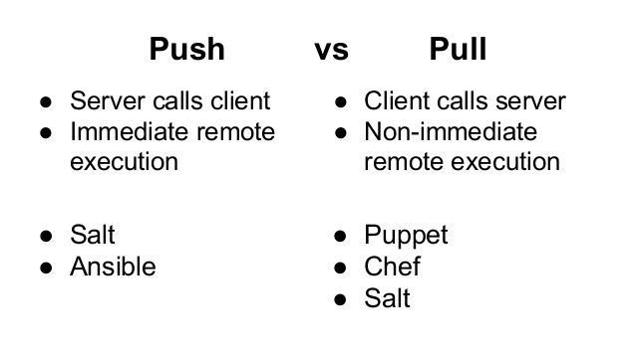
Types of Tools
<number>

Slide 9

What is Terraform?
Tool for building, changing and versioning infrastructure
Specializes in cloud infrastructure management
<number>

Slide 10
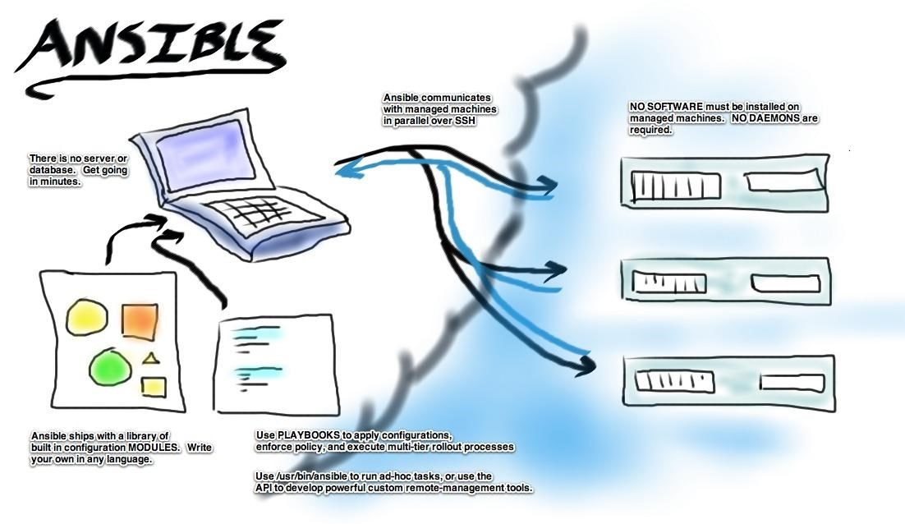
<number>

Slide 11
Why I chose Ansible
Simple
Learning curve
Galaxy and modules
Push - more convenient
Clarity - YAML
<number>

Slide 12

Design
<number>

Slide 13
What to Design?
EC2 Setup
Installs and reinstalls, dependencies
Tuning and customization
Replication
Backups
Monitoring
Failover
<number>

Slide 14

Is there any such thing as a
In Postgres automation?
<number>

Slide 15

YES
<number>

Slide 16

<number>

Slide 17
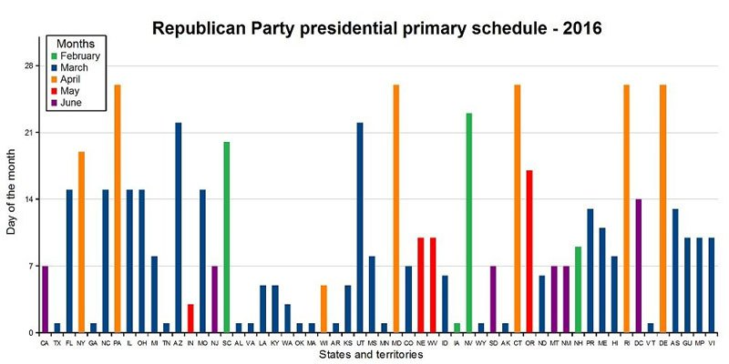
<number>

Slide 18

<number>

Slide 19

<number>

Slide 20

<number>

Slide 21

<number>

Slide 22
Setup and Initialization
<number>

Slide 23





EC2 Setup - variables
<number>

Slide 24
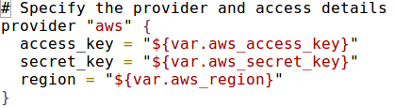
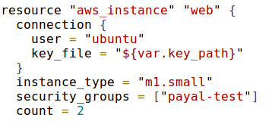
EC2 Setup - main.tf
<number>

Slide 25
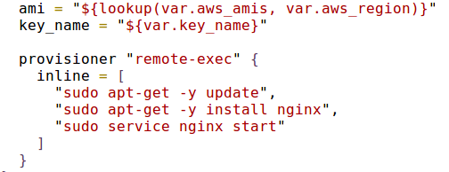
EC2 Setup - main.tf optionals
<number>

Slide 26
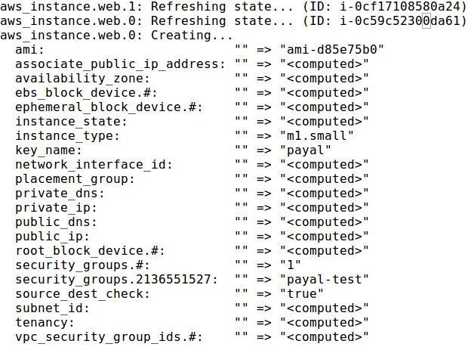
Terraform apply

Slide 27
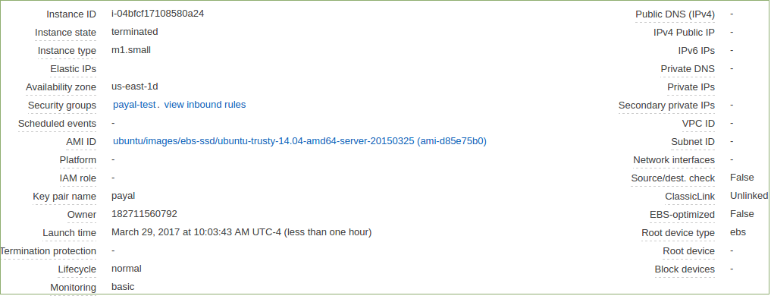
Terraform applied!

Slide 28
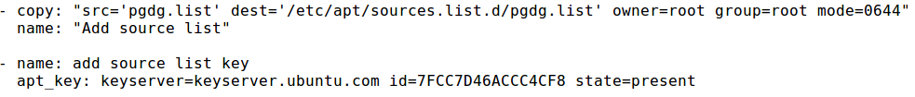
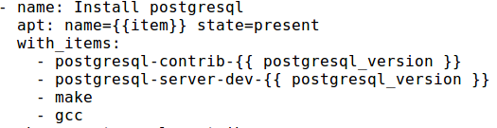
Installs
Get the repository:
Installing postgres and supporting packages:
postgresql_version: "9.6"
<number>

Slide 29
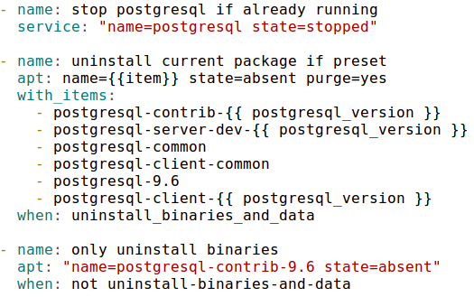
Re-installs
<number>

Slide 30


Customization
$PGDATA
Extensions
<number>

Slide 31
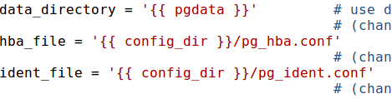
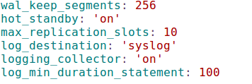
Tuning - postgresql.conf
Template files:
Attributes:
<number>

Slide 32
Tuning - pg_hba.conf
Template:
<number>

Slide 33

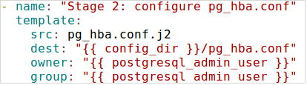
Tuning pg_hba.conf
Values:
File:
<number>

Slide 34
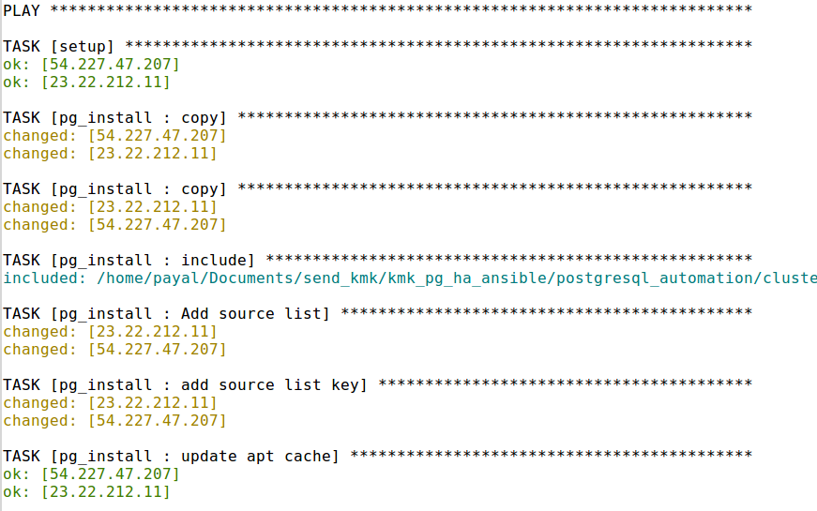
Ansible-playbook main.yml

Slide 35
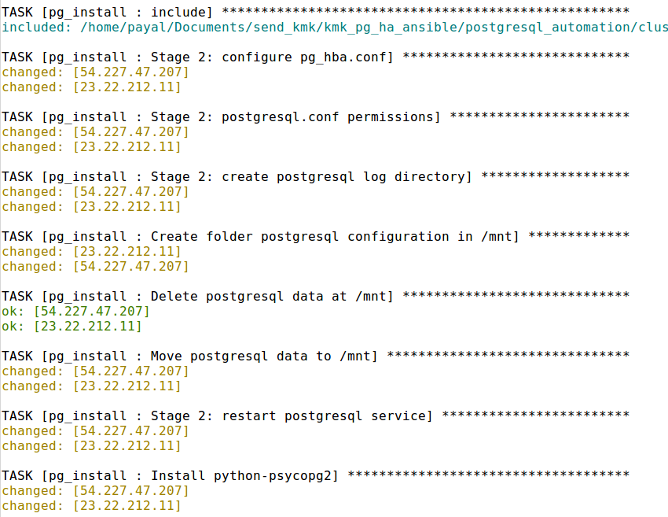

Slide 36
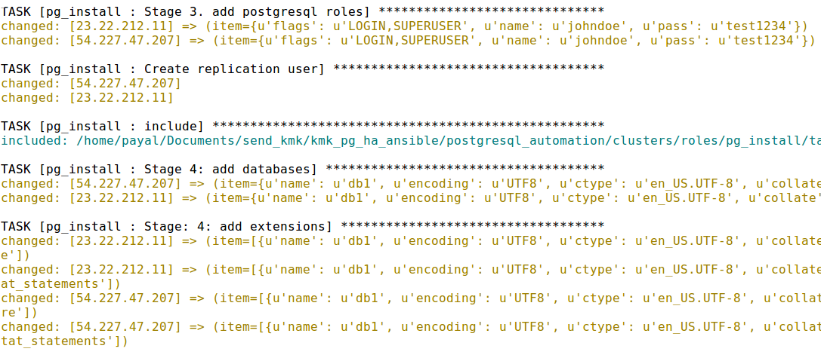

Slide 37

Replication
<number>

Slide 38
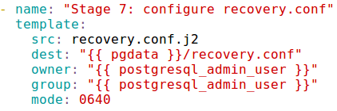
Replication – recovery.conf

Slide 39
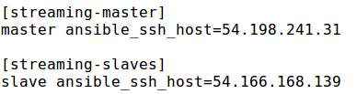
Ansible and replication
Groups:
<number>

Slide 40
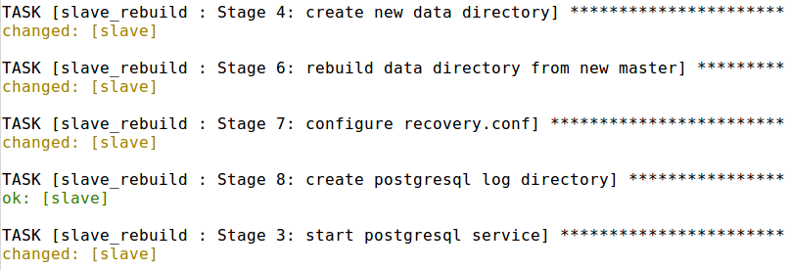

Slide 41
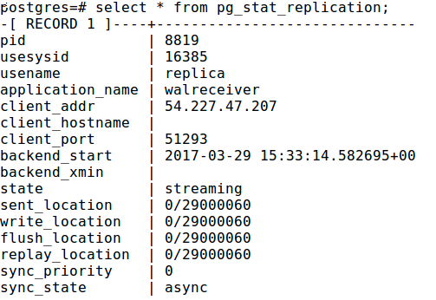

Slide 42
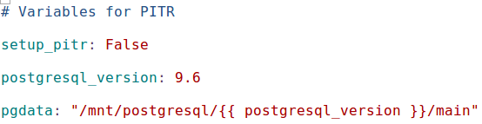
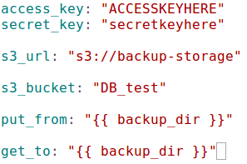
Backups and restores - Setup
PITR:
S3:
<number>

Slide 43
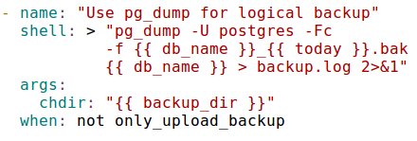
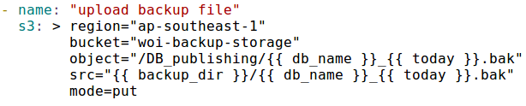
Backups
<number>

Slide 44

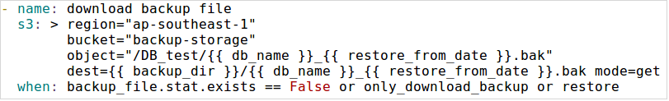
Restores
<number>

Slide 45
Configure PITR
<number>

Slide 46
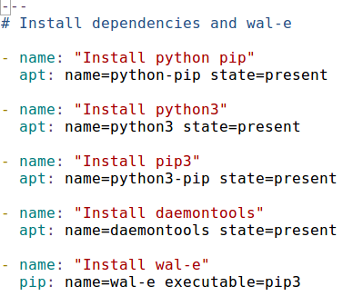
WAL-e dependencies
<number>

Slide 47
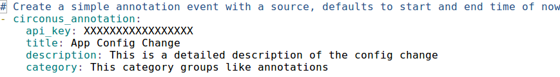
Custom Monitoring
http://docs.ansible.com/ansible/list_of_monitoring_modules.html

Slide 48
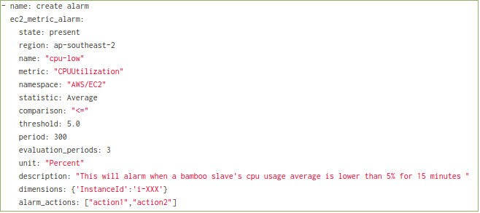
CloudWatch Monitoring

Slide 49


Failover
Boolean parameter:
promote_slave: False
<number>

Slide 51
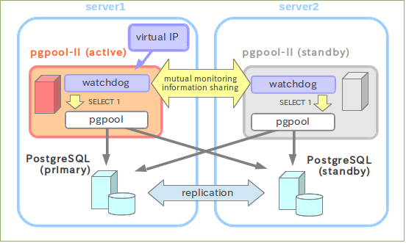
Completely Automated Failover
<number>

Slide 52
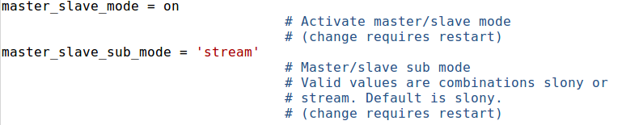
Pgpool

Slide 53
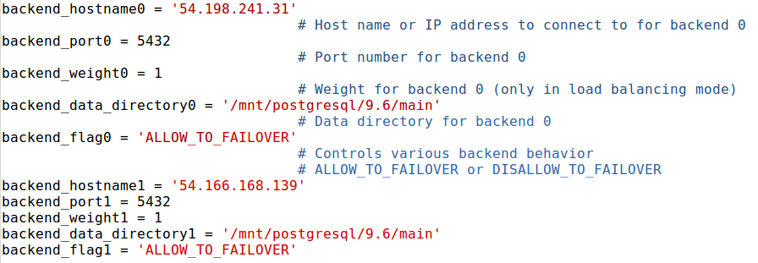
PgPool

Slide 54
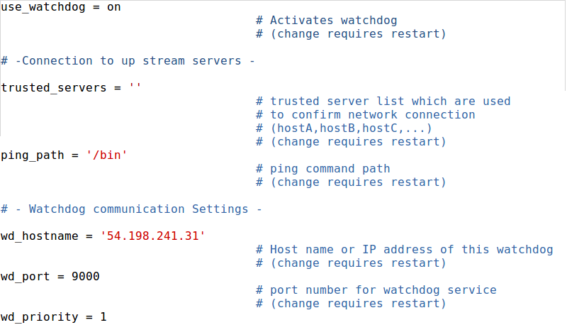
Watchdog

Slide 55
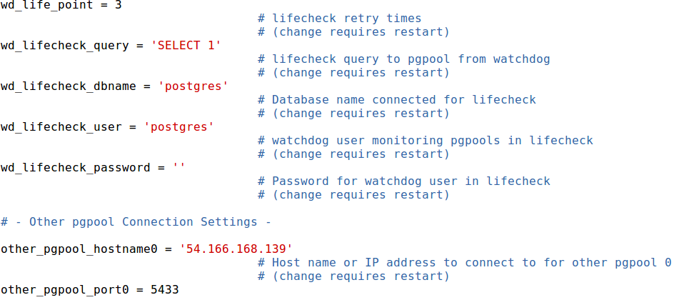
Watchdog

Slide 56
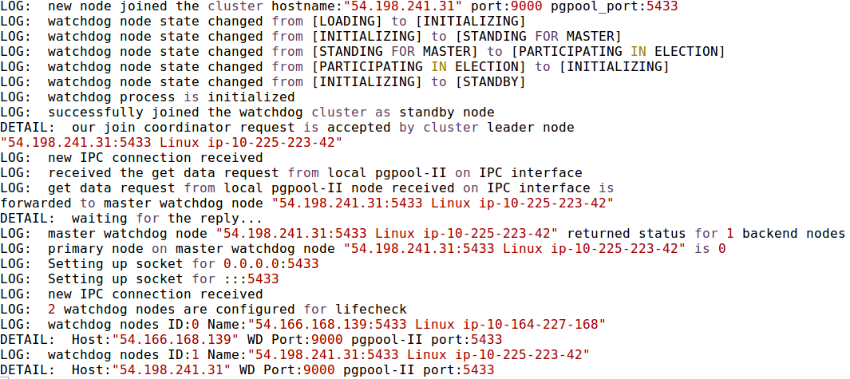
PgPool + Watchdog

Slide 57

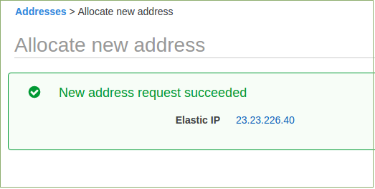
Virtual IPs
Elastic IP in AWS:
<number>

Slide 58

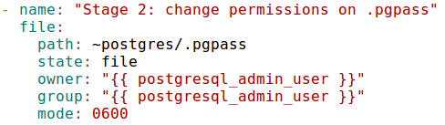
Pgpass file
<number>

Slide 59
Slave Rebuild
Switch
Base backup
<number>

Slide 60
pg_rewind
Synchronize a PostgreSQL cluster with another copy of the same cluster, after the clusters' timelines have diverged
9.5 and above
Superuser access
wal_log_hints = 'on' or enable data checksums
<number>

Slide 61
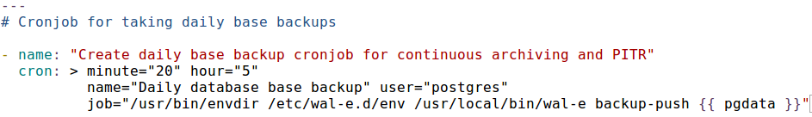
Cronjobs
<number>

Slide 62
Useful Links
https://github.com/payals/postgresql_automation
https://galaxy.ansible.com/
http://docs.ansible.com/
https://www.terraform.io/docs/
<number>

Slide 63
Questions?
<number>

